Slide 1
CCCF19
CODEX COMMITTEE ON CONTAMINANTS IN FOODS
Agenda item 6: CODE OF PRACTICE FOR THE PREVENTION AND REDUCTION OF TROPANE ALKALOID CONTAMINATION IN FOOD AND FEED
CX/CF 26/19/6；CX/CF 26/19/6-Add.1
Yongning WU, Dr
Yi SHAO, Dr
China National Center for Food Safety Risk Assessment
PRE-CCCF19 MEETINGS, October 9, 2026

Slide 2

Objectives
Discuss CL 2026/52-CF comments
Seek agreement on Recommendations in the Working Paper:
Recommendation (i): Consider whether the proposed CoP is ready for advancement in the Step Procedure.
Recommendation (ii): Consider whether the Annex should be retained, taking into account practical utility, greyscale clarity, and copyright clearance.
Recommendation (iii): If not ready for advancement, identify key issues that require further consideration.

Slide 3
Comments in response to CL 2026/52-CF
Submitted by: Australia, Canada, Chile, Ecuador, Egypt, EU, Iran, Iraq, Japan, Mozambique, New Zealand, Paraguay, Peru, Senegal, Singapore, Sudan, Thailand, Türkiye, USA, ISDI.
General Position:
Broad support for advancement.
Divergence on pace: Step 5/8 (USA, EU, Singapore, Canada, NZ, Türkiye, Iran) vs Step 5 (Japan, Paraguay, Chile, Egypt); Ecuador requests additional technical review.

Slide 4
Comments for Annex I
Annex I
Broad support for retention, subject to copyright, greyscale clarity, and diagnostic value.
Thailand supports retaining the colour format and ensuring Datura spp. is consistently italicised.
USA suggests adding size ranges and arrows, or keeping Annex I as a CCCF website document.
Notes:
The USA suggests adding size ranges and arrows, or alternatively keeping Annex I as a CCCF website document. Thailand supports retaining the colour format and ensuring that Datura spp. is consistently italicised.
On Annex I, there is broad support for retention. Members agree that the Annex should be kept, subject to three conditions: copyright clearance, clarity when reproduced in grayscale, and sufficient diagnostic value—meaning the images must remain useful for identification even without colour.

Slide 5
Key Revisions Made in Response to Comments
Introduction: Moved management recommendations out; revised clinical signs wording; clarified milk monitoring.
Scope / General Considerations: Limited Scope; created “General Considerations” for paras 13–14; added future TA genera;recognized national capacity differences; distinguished essential vs complementary measures.
GAP: Recognized pseudocereals; softened conservation tillage; changed “must”→”should”; revised irrigation systems; deleted seed treatment sentence;added climate factors and regional surveillance.
GMP: Emphasized supplier controls; added risk-based verification; deleted traceability paragraph; integrated training.
Testing: Clarified JECFA levels; retained tiered testing;added risk-based representative sampling.
Consumer: Softened language.

Slide 6
Comments Not Incorporated (1/5)
Comment | Rationale | Related Text
EU: “cereal products” instead of “Super Cereal” | Direct citation from FAO/WHO expert meeting report, which specifically evaluated “Super Cereal”. Broadening the term would inappropriately extend the original scientific reference. Values retained as background information only. | Retained text:“Although Codex has not established MLs for TAs, manufacturers could consider voluntary reference values for TAs in food (e.g., JECFA's recommended intervention levels of 30 μg/kg for super cereal, 10 μg/kg for super cereal plus and lipid-based nutrient supplements²).” ² Joint FAO/WHO Expert Meeting on Tropane Alkaloids (2020). "Super Cereal" and "Super Cereal Plus" refer to specialised nutritious foods used in World Food Programme (WFP) food assistance programmes, as evaluated in the report. https://cdn.who.int/media/docs/default-source/food-safety/jecfa/summary-and-conclusions/tropane-alkaloids-expert-meeting_30-march-3-april-2020_executive-summary.pdf?sfvrsn=f6c51fc1_5 https://openknowledge.fao.org/server/api/core/bitstreams/6f846395-4481-46ca-850d-8953ae8ccb38/content
Japan: Add national maximum levels | Not appropriate for a Codex Code of Practice, which focuses on risk-based preventive controls and should not reference or coordinate national regulatory limits.

Slide 7
Comments Not Incorporated (2/5)
Comment | Rationale | Related Text
Türkiye: Change GAP/GMP section titles to “primary production” and “food establishments” | Existing CCCF CoPs generally use “Good Agricultural Practices (GAPs)” in section headings; “primary production” is not used as a heading in CCCF CoPs. CXC 1-1969 uses “Primary Production,” but that is a CCFH text with a different scope. Therefore retain existing titles. | Retained titles: RECOMMENDED PRACTICES BASED ON GOOD AGRICULTURAL PRACTICES (GAP) / RECOMMENDED PRACTICES BASED ON GOOD MANUFACTURING PRACTICES (GMP)

Slide 8
Comments Not Incorporated (3/5)
Comment | Rationale | Related Text
USA: Terminology in para 64 (LC-MS/MS, LC-HRMS, QuEChERS, SPE) too technical for a CoP | Retained for clarity of testing methods. No better alternative found unless this part is deleted. Technical terms are necessary for analytical precision. | Retained text: “LC-MS/MS and LC-HRMS are the most reliable and widely used methods for TA analysis in food and feed... Dilute and shoot approach or sample preparation using QuEChERS or SPE... ensures reliable identification and quantification even at trace levels.”

Slide 9
Comments Not Incorporated (4/5)
Comment | Rationale | Related text
Senegal: Retain advice on separation of medicinal and food products during storage | During EWG discussions, it was noted that TA-containing medicinal products are generally available as extracts, drops, patches, tablets, or injections, often under prescription or regulatory controls, rather than as raw leaves or seeds. Accidental food contamination from medicinal use was considered unlikely; cross-contamination not a realistic risk. The paragraph was therefore deleted. | Deleted text: “Although TA-containing medicinal products are generally subject to regulatory controls, some TA-containing plants have traditional medicinal uses. Risk communication materials may explain the difference between medicinal and food uses and advise consumers to follow medical guidance and store such products separately from food to avoid accidental cross-contamination.”

Slide 10
Comments Not Incorporated (5/5)
Comment | Rationale | Related text
USA: Delete consumer education sentence on mistaking toxic plants for vegetables | Retained as essential risk communication specific to this hazard and aligns with the purpose of the Consumer Practices section. The sentence helps prevent accidental ingestion. | Retained text: “Educational materials should help consumers recognize the risks and respond appropriately in case of accidental ingestion, and avoid exposure by mistaking toxic plants for vegetables when purchasing foods, growing or foraging for their own food.”

Slide 11
Key Issues for Advance Discussion
For CCCF decision
Advancement: Step 5 vs Step 5/8.
Annex I: retention subject to copyright/greyscale; website fallback option.
Intervention levels: Super Cereal wording, exclusion of national MLs, footnote handling.
Post-meeting EWG technical-editorial finalization
Consistent application of the defined term Datura (clean-up residual Datura spp. occurrences in text)
Confirm text structure of Scope section and General Considerations

Slide 12
Recommendation to CCCF19
Broad support for advancement.
Recommend forwarding the revised CoP to CAC50 for adoption at Step 5/8, with editorial amendments.
If no consensus, advance to Step 5 for further consideration.
Proposed handling for Annex I:
‑Preferred: Retain Annex I within the CoP text, conditional on copyright clearance and greyscale review; arrows may be added if copyright permits; size ranges not feasible with current images.
‑Fallback contingency: If copyright clearance is unsuccessful, relocate Annex I as a supporting document on the CCCF website (outside main CoP text).

Slide 13
THANK YOU FOR YOUR ATTENTION
Codex Committee on Contaminants in Foods

Slide 14
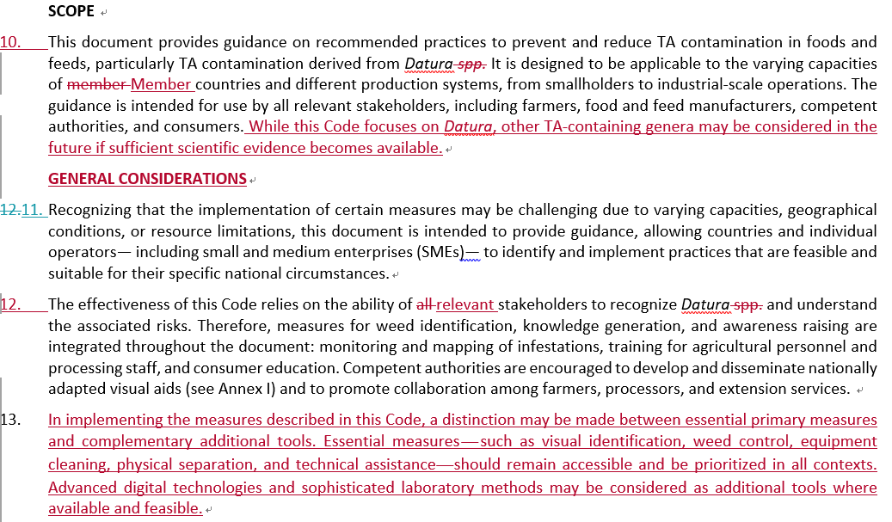
Backup-Text excerpts for technical-editorial confirmation items
1. Scope section

Slide 15
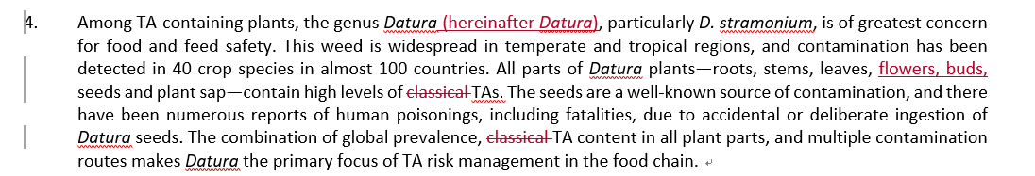
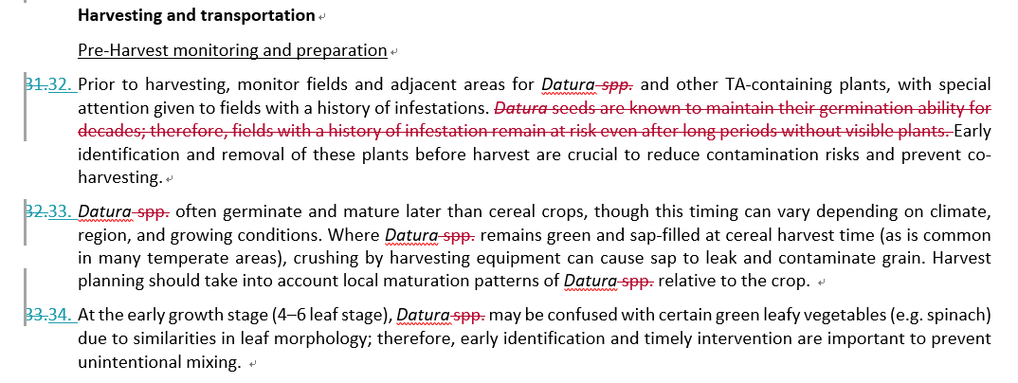
Backup-Text excerpts for technical-editorial confirmation items
2. Item: Consistent italic formatting for Datura spp.

